Slide 1
Chapter 5 Linear Models

Slide 2
Linear Models
General linear models are a class of model that includes regression, multiple regression, ANOVA, and ANCOVA.
All of these are fundamentally linear models.
These models share a common framework for estimation (least squares) and a common set of assumptions, centered around the idea of normally distributed residuals.
Don’t confuse the general linear model with the generalized linear model (different assumptions).

Slide 3
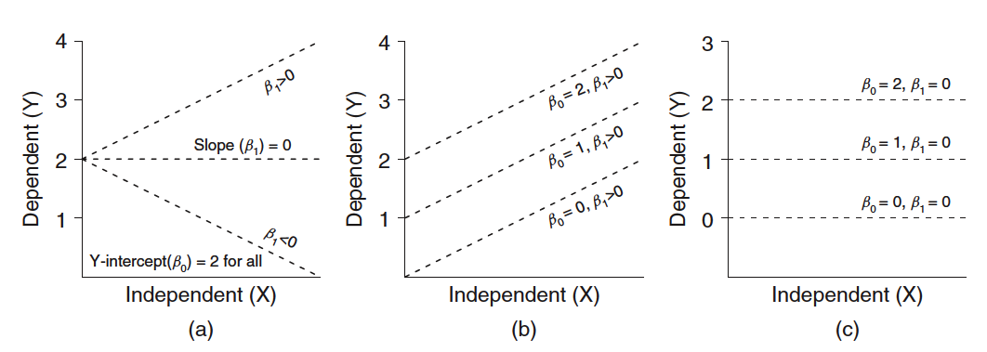
GLM: Comparing Regression Coefficients
The formula for a General Linear Model:
Y = predicted value of variable Y
β₀= Y-intercept
β₁= slope
X = value of X variable
ε = error
Notes:
E = error

Slide 4
Linear Models
lm() is the basic function for fitting linear models
Our initial examples will focus on the relationship between two continuous variables (1 predictor/1 response)
plant_gr <- read.csv("plant.growth.rate.csv")
glimpse(plant_gr)
ggplot(plant_gr,
aes(x = soil.moisture.content, y = plant.growth.rate)) +
geom_point() +
ylab("Plant Growth Rate (mm/week)") +
theme_bw()

Slide 5
Two parameters of Interest:
Y-Intercept and Slope
Let’s take a guess…
Intercept looks to be between 15-20
Slope of the relationship is obviously positive
Y-units between 20-50 = 30 units and
X-units between 0-2.0 = 2 units.
Slope is around 30/2 or 15
Biological interpretation = 15 mm in growth (per week) with every 1 unit increase in soil moisture

Slide 6
Fit the model
model_pgr <- lm(plant.growth.rate ~ soil.moisture.content,
data = plant_gr)
This reads, “Fit a linear model, where we hypothesize that plant growth rate is a function of soil moisture content, using the variables from the plant_gr data frame.”
Notice that people often choose to use the type of object as a prefix in object name (we have seen this before) ; more intuitive
model_abcd
figure_abcd
table_abcd
data_abcd
Note also that response variable specified first, predictor variable second; opposite of ggplot2 specifications

Slide 7
Check the assumptions
library(ggfortify) #quick model diagnostics
autoplot(model_pgr, smooth.colour = NA)

Slide 8
Points flagged as potentially problematic are identified by number (in order of occurrence in dataframe)
Top-left: should be scatter-shot; no obvious hump-shapes or U-shaped distribution
Top-Right: Evaluates assumption of normality; dots should all be very nearly on the expected line
Bottom-Left: Evaluates assumption of equal variance; should be scatter-shot
Bottom-Right: Detects outliers ‘leveraging’ the distribution.
Generally, things look OK.

Slide 9
Model Interpretation
anova() produces a classic table in statistics, the sums-of-squares table.
It provides the overall F-value for the model, representing the ratio of variance explained by the explanatory variables (only one in this case; soil moisture) to the leftover variance (this is the ANOVA part).
P-value evaluating the null hypothesis (slope = zero)
Analysis of Variance Table
Response: plant.growth.rate
Df Sum Sq Mean Sq F value Pr(>F)
soil.moisture.content 1 2521.15 2521.15 156.08 < 2.2e-16 ***
Residuals 48 775.35 16.15
---
Signif. codes: 0 ‘***’ 0.001 ‘**’ 0.01 ‘*’ 0.05 ‘.’ 0.1 ‘ ’ 1

Slide 10
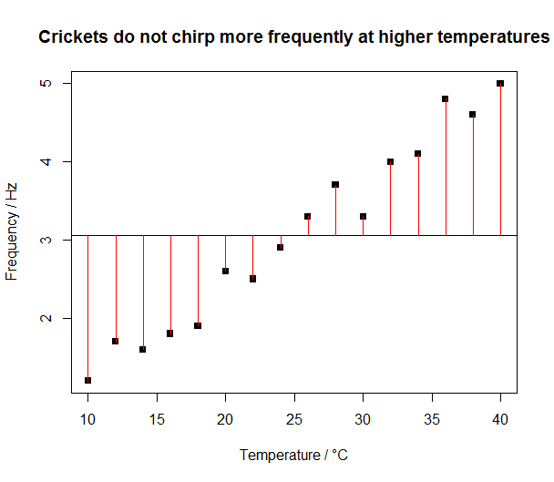
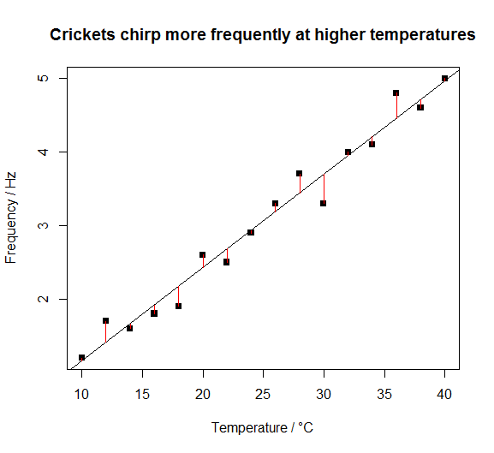
Testing the Null Hypothesis
https://www.polypompholyx.com/2014/02/r-linear-regression/

Slide 11
Model Interpretation
summary() produces estimates of the coefficients of the line that is “the model”: an intercept and a slope
Call:
lm(formula = plant.growth.rate ~ soil.moisture.content, data = plant_gr)
Residuals:
Min 1Q Median 3Q Max
-8.9089 -3.0747 0.2261 2.6567 8.9406
Coefficients:
Estimate Std. Error t value Pr(>|t|)
(Intercept) 19.348 1.283 15.08 <2e-16 ***
soil.moisture.content 12.750 1.021 12.49 <2e-16 ***
---
Signif. codes: 0 ‘***’ 0.001 ‘**’ 0.01 ‘*’ 0.05 ‘.’ 0.1 ‘ ’ 1
Residual standard error: 4.019 on 48 degrees of freedom
Multiple R-squared: 0.7648, Adjusted R-squared: 0.7599
F-statistic: 156.1 on 1 and 48 DF, p-value: < 2.2e-16

Slide 12
The t- and p-values provide tests of whether the model coefficients (slope and intercept) are different from zero (the null statistical hypothesis)
In fact, we might even report something like the following:
“Soil moisture had a positive effect on plant growth. For each unit increase in soil moisture, plant growth rate increased by 12.7 mm/week (slope = 12.7, t = 12.5, d.f. = 48, p < 0.001).”
In case you were wondering, it is also be fine to report the F-value, degrees of freedom, and the p-value from anova(). They test exactly the same thing in this example (because there is only a single predictor variable, soil moisture). This isn’t generally true of all GLMs.

Slide 13
Add Model Predictions (Fit-Line) to Figure
ggplot(plant_gr, aes(x = soil.moisture.content,
y = plant.growth.rate)) +
geom_point() +
geom_smooth(method = 'lm') +
ylab("Plant Growth Rate (mm/week)") +
theme_bw()

Slide 14
The new feature here is the layer:
geom_smooth(method = "lm")
This is ggplot2-speak for ‘shove a linear-model fitted line, and the standard error of the fit
This works well with facet_wrap(), fitting different lines for each panel ‘group’ (categorical) variable

Slide 16
Practice (cont. from last time)
Divide into 4 groups of 4-6 people
Analyze one of the assigned questions using the tools we have learned: readr, tidyr, dplyr, ggplot2
Import and store data in useable format (hint: use Rproject)
Reformat the data as needed
‘Tidy’ the data as needed
Make two different graphical depictions of the answer
Produce a t-test for the comparison
Give a fully annotated ‘results’ statement (Beckerman p. 102 for chi-square reporting example; change so it is appropriate for t-test)
Group will present to the class with a fully reproducible example (full R script execution; results statement at bottom of script).

Slide 17
Practice Questions (cont.)
Does taking ‘Alpha Brain’ improve memory?
Which country produces cars with higher gas mileage?
Does cholesterol differ among genders?
How does where you live (location) influence baseline glucose?

Slide 18
Linear Regression
Determines the association between two continuous variables.
H_{o}: β₀ = 0
H_{a}: β₀ ≠ 0
H_{o}: β₁ = 0
H_{a}: β₁ ≠ 0
Test slope = 0
Test Y-intercept = 0
Age (days) | Wing Length (cm)
3 | 1.4
4 | 1.5
5 | 2.2
6 | 2.4
8 | 3.1
9 | 3.2
10 | 3.2
11 | 3.9
12 | 4.1
14 | 4.7
15 | 4.5
16 | 5.2
17 | 5
“There is a significant relationship between age and wing length in sparrows (r² = 0.97, F_{1,11} = 401.09, P < 0.0001). For each additional day in age, wing length was predicted to increase 0.27 cm.”
Notes:
This is simple linear regression. Just another general linear model (GLM). Usually not interested in testing whether y-intercept = 0.
20 nests, 1 random nest sampled per day; else repeated measures design necessary.
In all regressions the line is fit through the mean of X and mean of Y; software fits line via OLS, which minimizes the distance between points and a fitted line

Slide 19
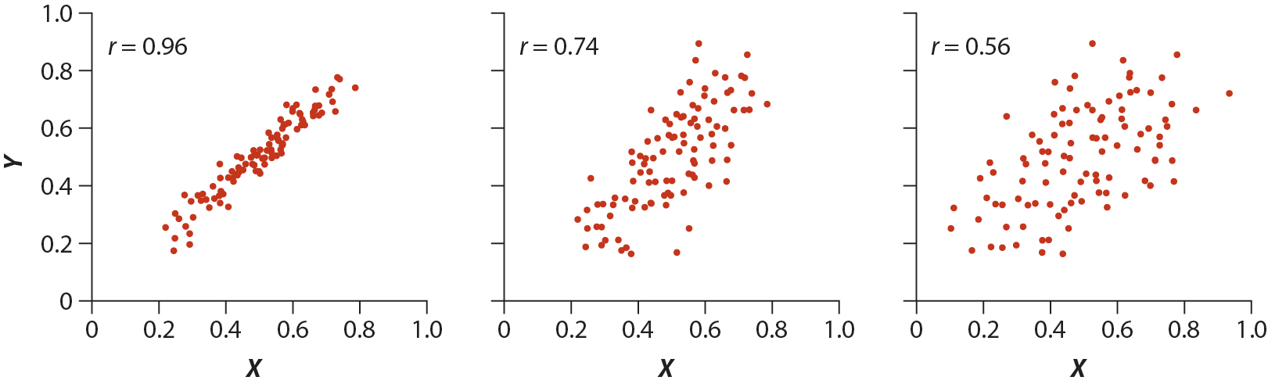
r² = coefficient of determination
2
2
2
96% of the variability in Y can be attributed to X.
4% of the variability due to measurement error or some other biological factor.
56% of the variability in Y can be attributed to X.
44% of the variability due to measurement error or some other biological factor.
Notes:
See also:
https://en.wikipedia.org/wiki/Anscombe%27s_quartet

Slide 20
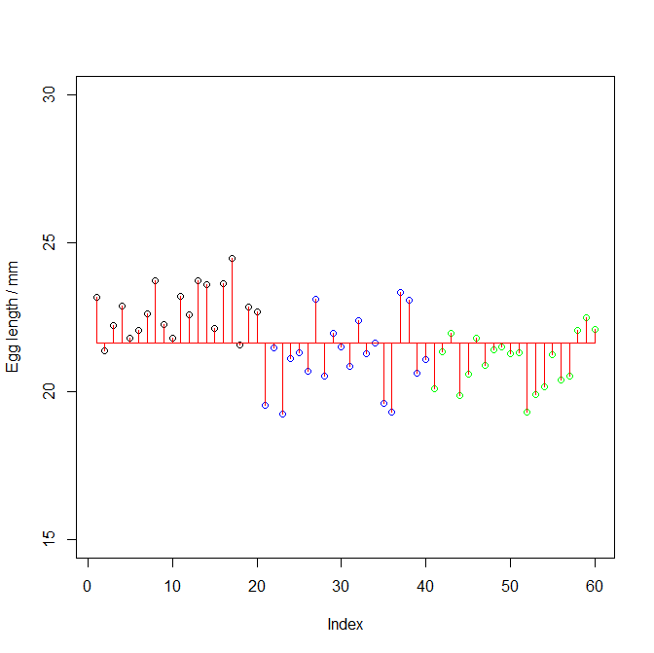
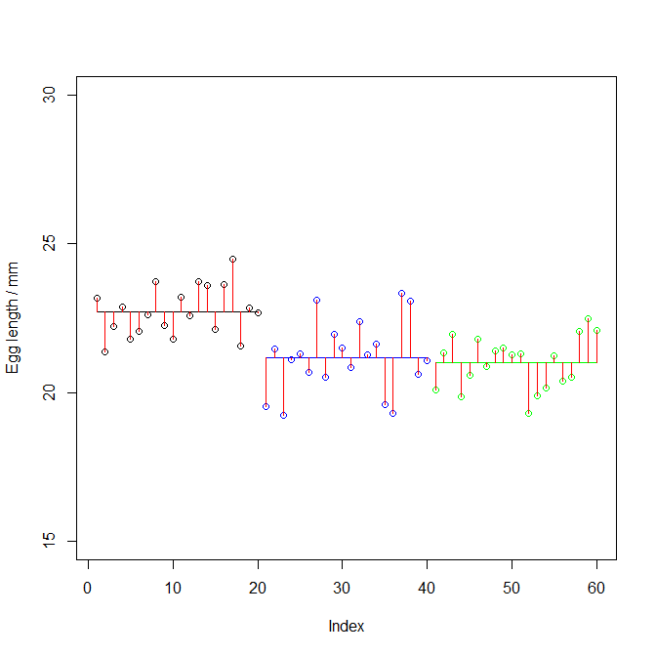
Null Hypothesis in ANOVA
Notes:
https://www.polypompholyx.com/2014/02/r-anova-1-way/

